Slide 1
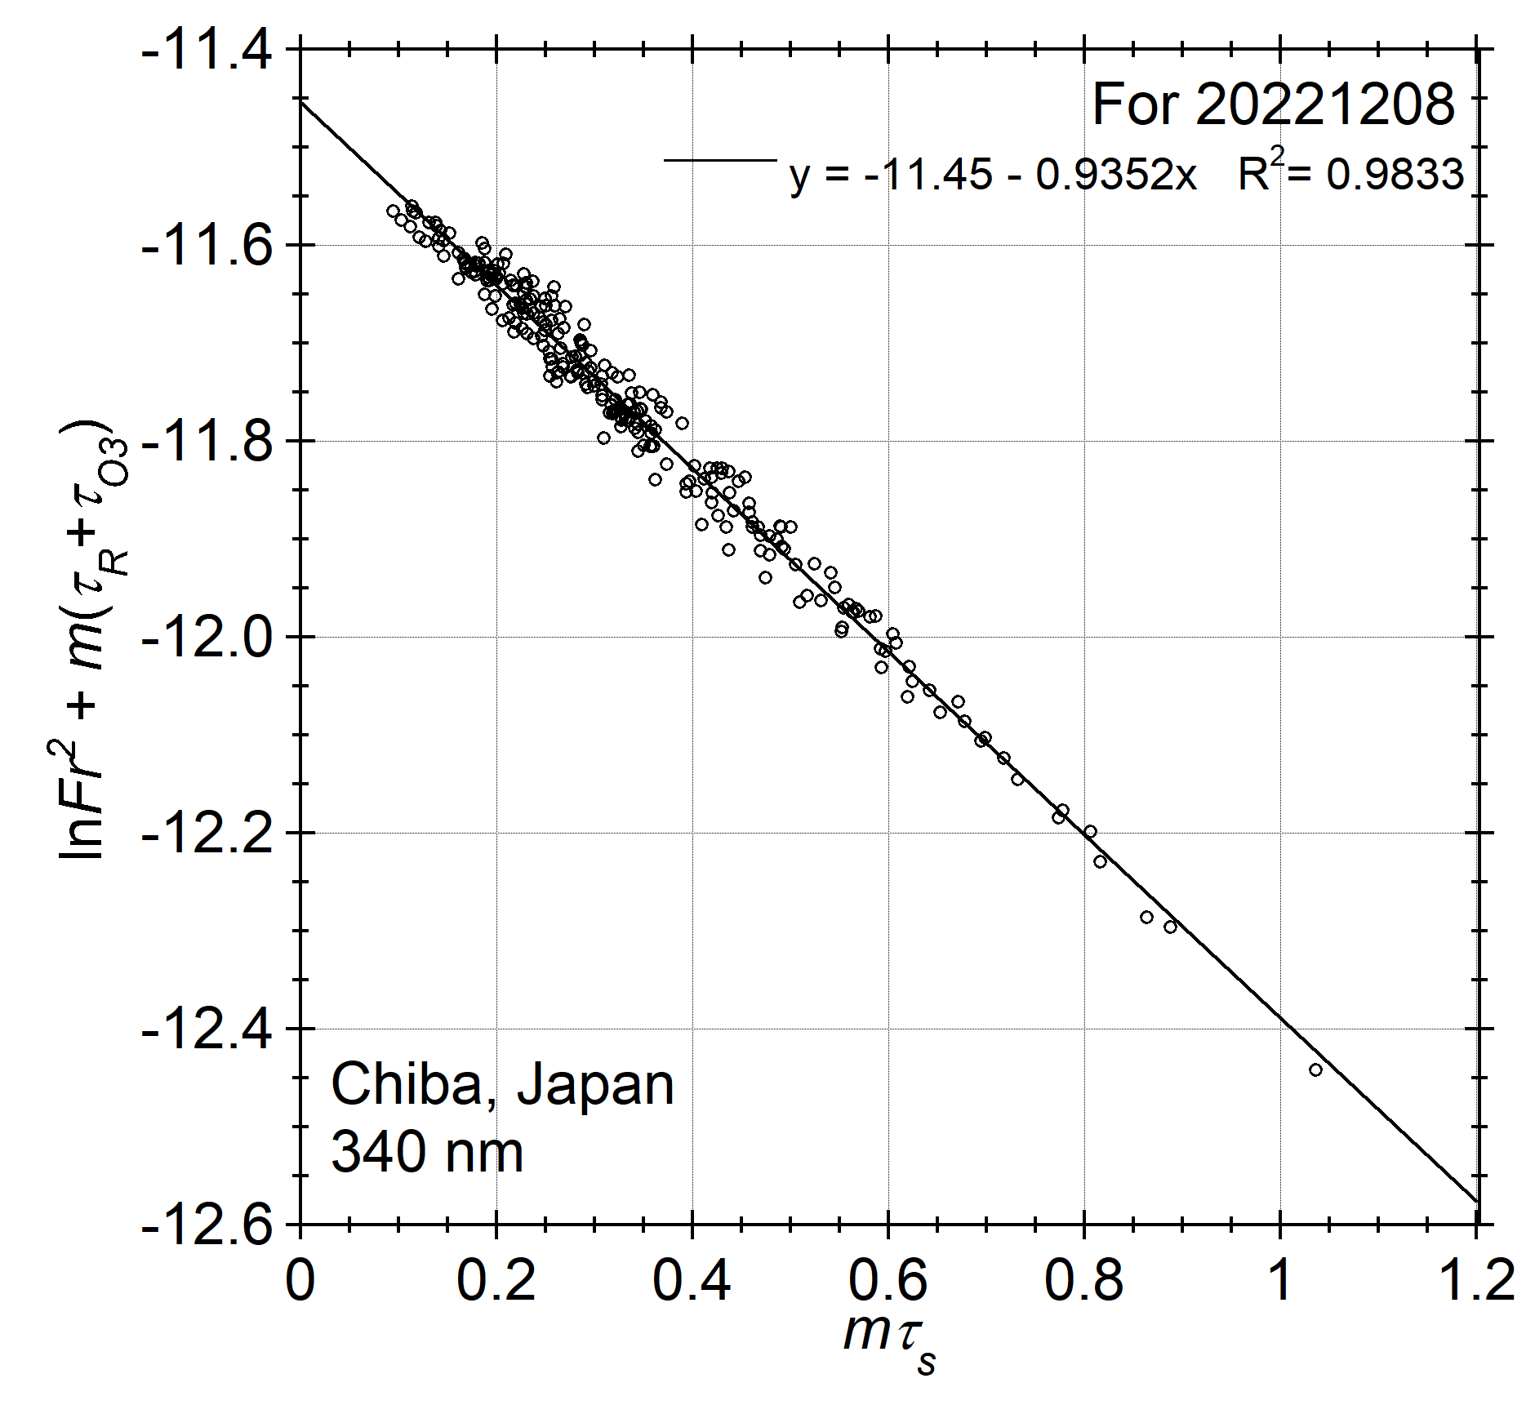
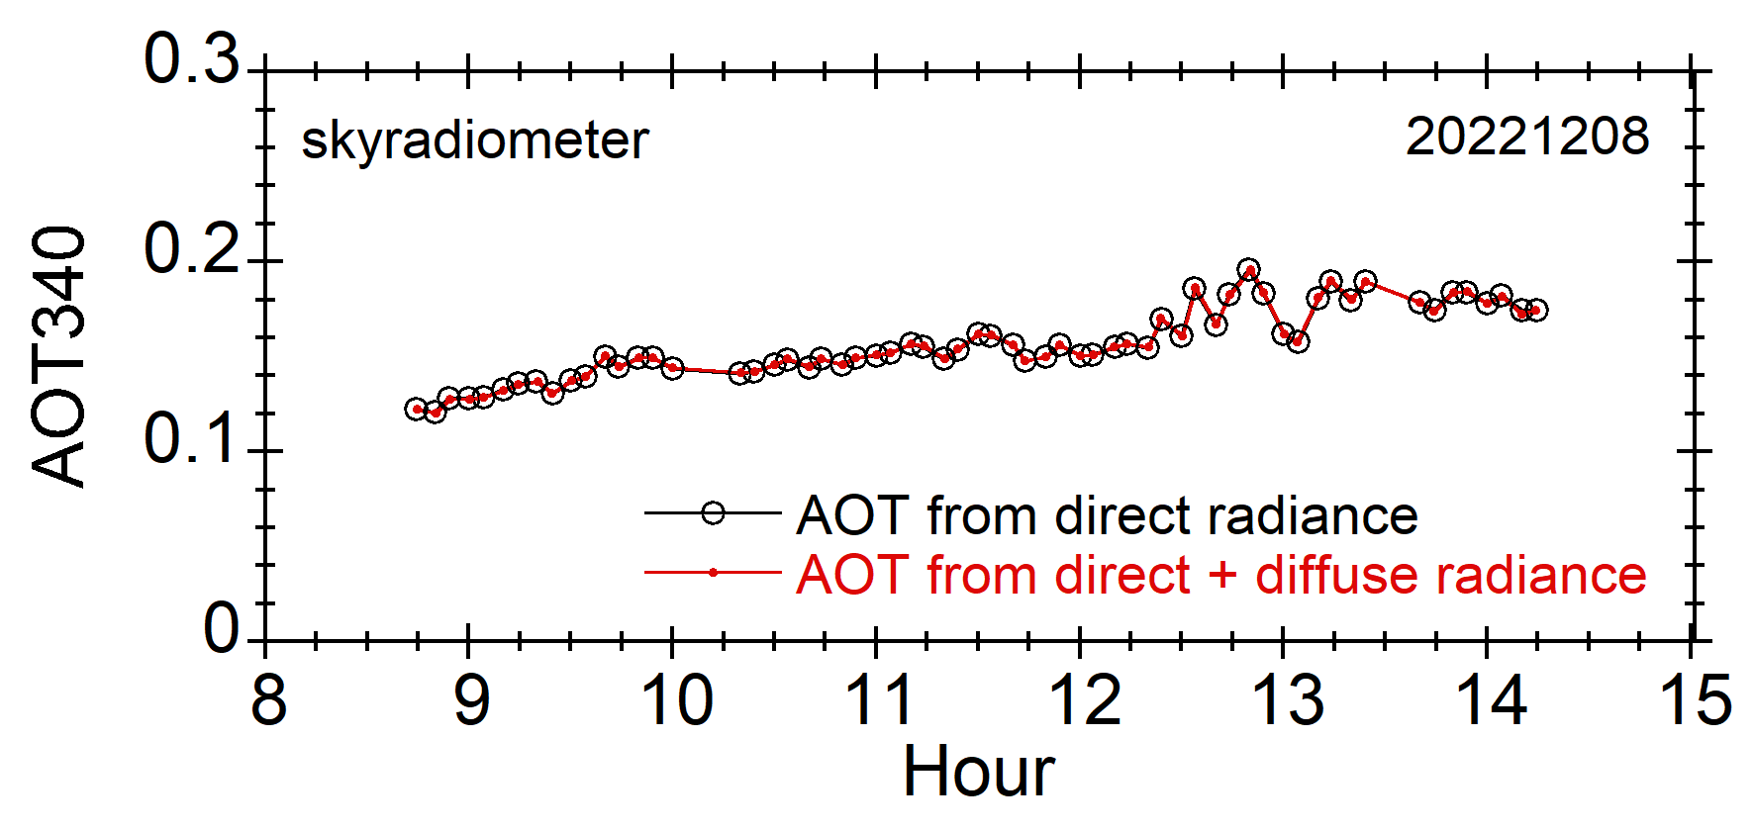
On quality of skyradiometer AOT
Improved Langley plot
Consistency between two AOT340 values:
1) retrieved using direct radiance only vs. 2) retrieved using both direct & diffuse radiances

